Slide 1



vFlashCards_____________
Flashcards at your fingertip.
Study aids on the go.
CISC 4900 Brooklyn College - City University of New York
Professor Chuang
Professor Lapid
Min-Chun Lo

Slide 2
What & Why?
Full stack web application virtual flashcards. Built on PostgreSQL, Express, React, Node.js.
Because everything can be organized in one place.
Convenience of study aids for students on the go.
Not easily misplaced.

Slide 3
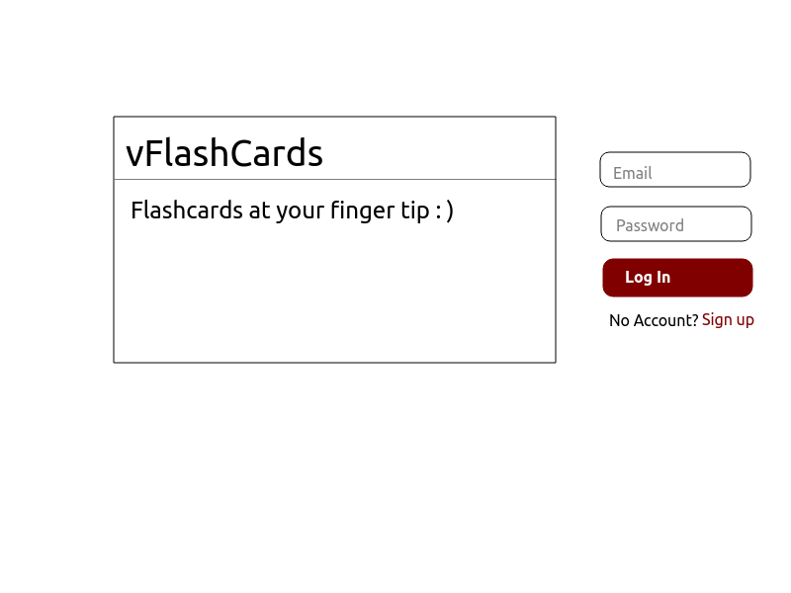
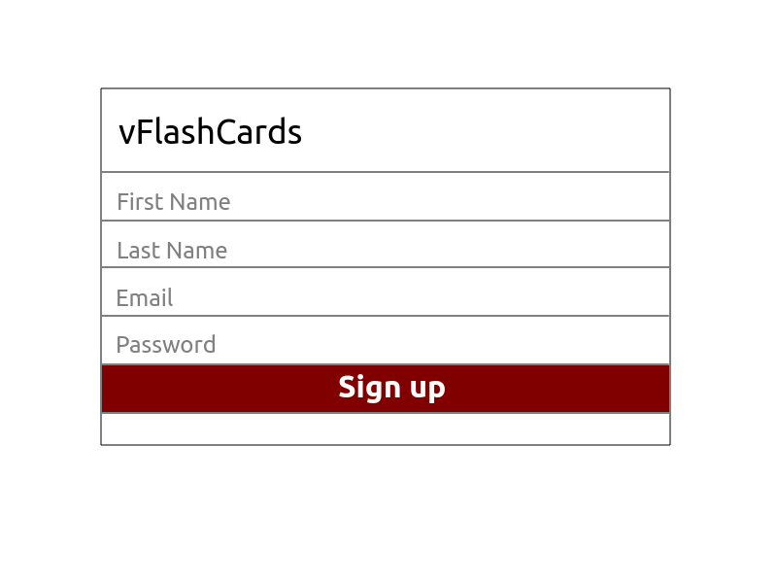
UI/Mockup
Home / Landing page
Signup

Slide 4
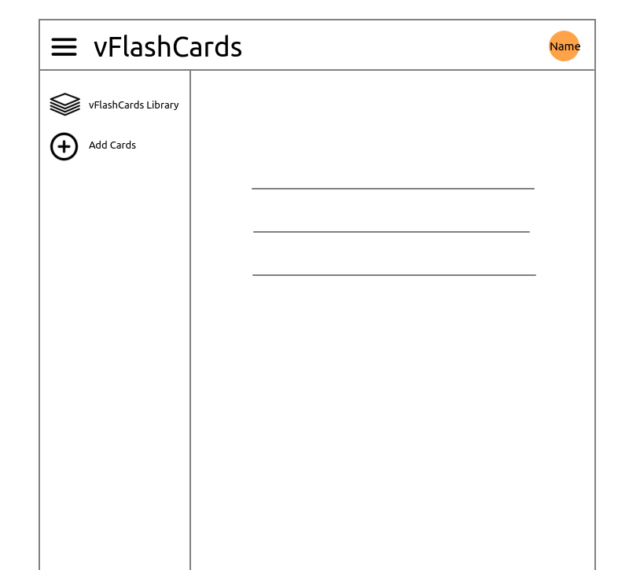
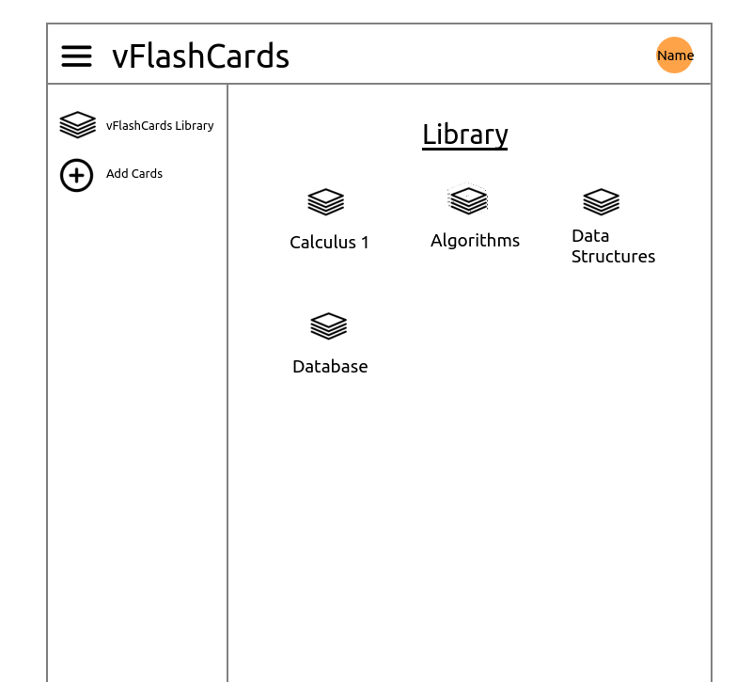
UI/Mockup
Profile
Library

Slide 5
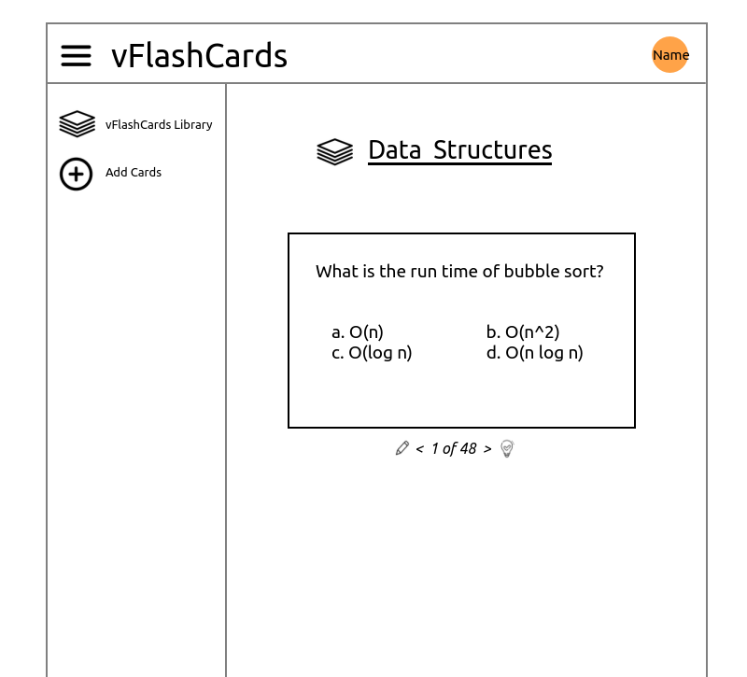
UI/Mockup
Flashcard

Slide 6
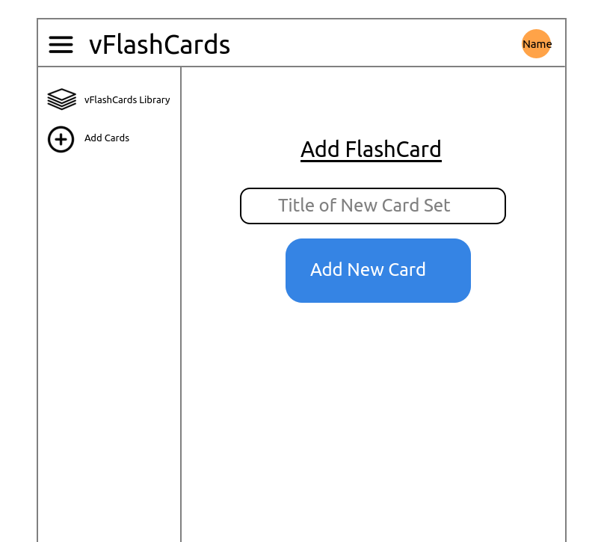
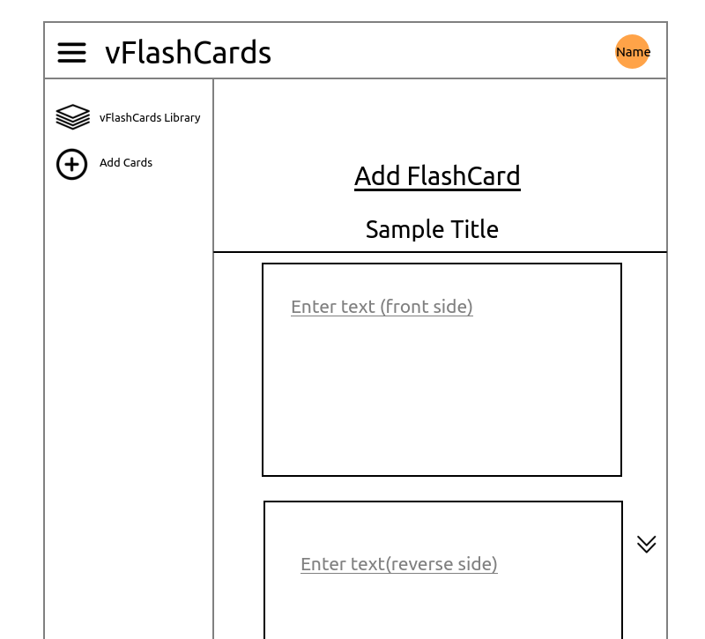
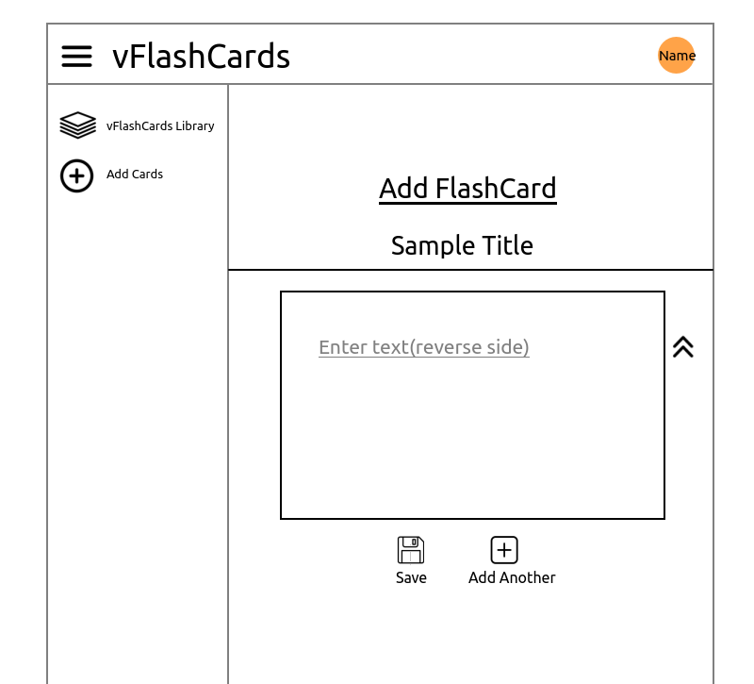
UI/Mockup
Add card set
Add question
Add answer and save
Note: Mockup created on KolourPaint (Linux). Not recommended as a first choice. Google Drawings can be a good choice due to its low learning curve and features. Frontend to be built before the end of the semester.

Slide 7
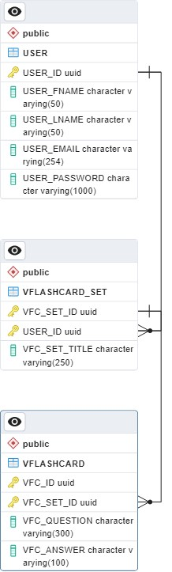
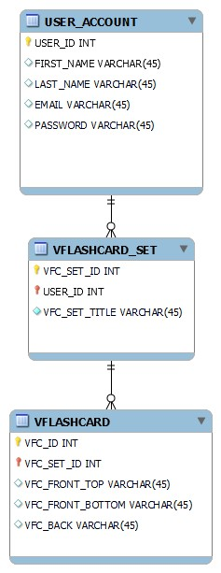
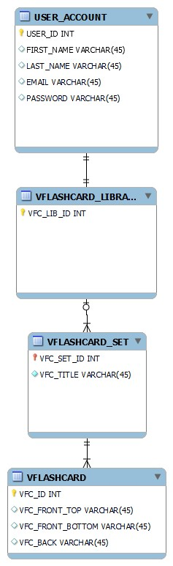
Behind the Scenes Backend
Database ERD
Recreated ERD. Amended the column name and data type.
First ERD, which shows what I thought the data should be structured.
Deleted redundant table as per recommendation from Edgardo Molina
Generated script (via pgAdmin) required double quotes for all tables, which was unexpected..
Deleted all existing tables and recreated them scratch.
The database schema from inception, which went through iterations to arrive at the current one as seen on the next page. Also, generated scripts may not result in expected result. In the above, tables needed to be double quoted for SQL query.

Slide 8
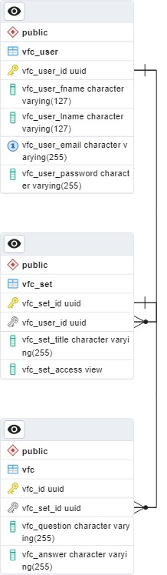
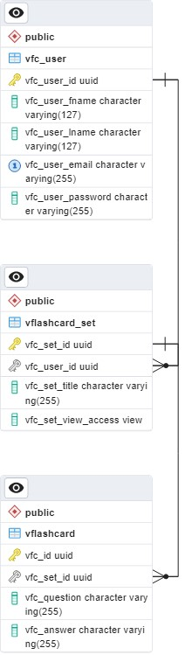
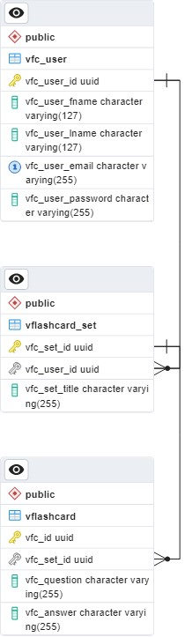
Behind the Scenes Backend
Database ERD
Added additional attribute under vflashcard_set for view access.
Shorten table names for convenience.
(Less typing during coding & debugging processes.)
Updated the primary key to using a single attribute instead of two.
Done as a workaround for failed attempts to create the third table, vflashcard.
Implemented an ENUM type (public/private) as suggested by Edgardo Molina.
Note: ER diagrams were created using MySQL WorkBench (first two ERD) and pgAdmin from PostgreSQL. Both are available from the official website at no cost as of 2023-11.

Slide 9
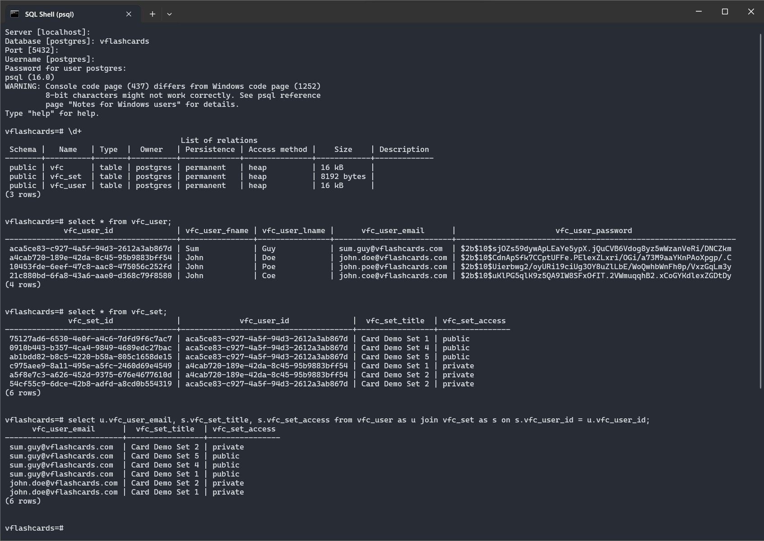
Behind the Scenes Backend
PostgreSQL Database
List of relations / tables
Querying user list & card sets.
Joining tables to get users who have card sets, which list email, associated card sets, and the access type.

Slide 10
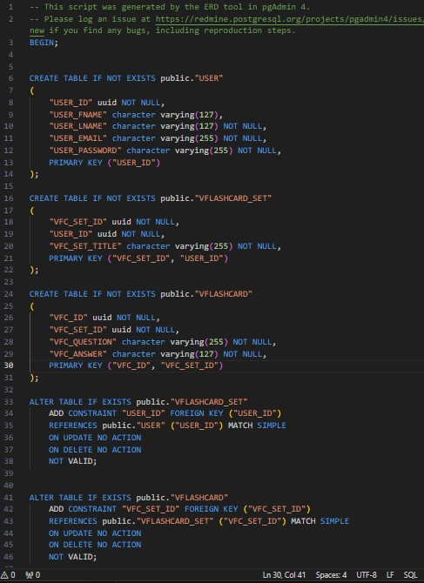
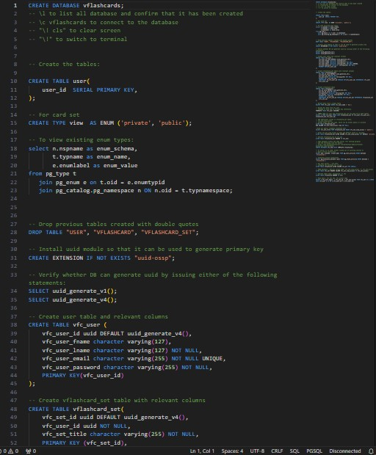
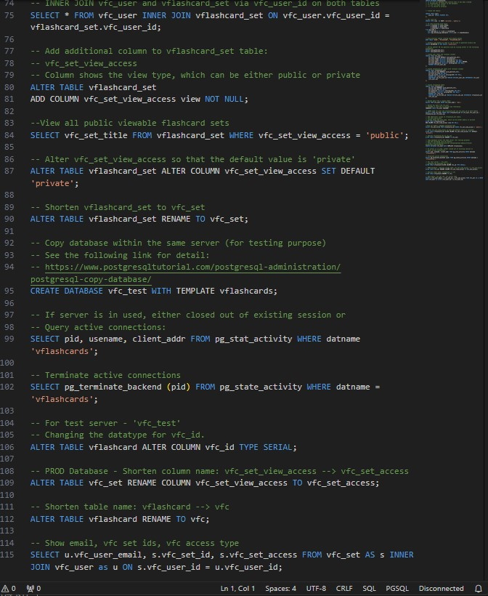
Behind the Scenes Backend
SQL Query Journal
List of queries used up to now.
Note: Producing a journal takes time, but is helpful for record keeping. It also allows for quick references on previously used queries and can serve as a reminder as to why particular decisions took place.
Generated script by pgAdmin. Did not produce expected result.

Slide 11
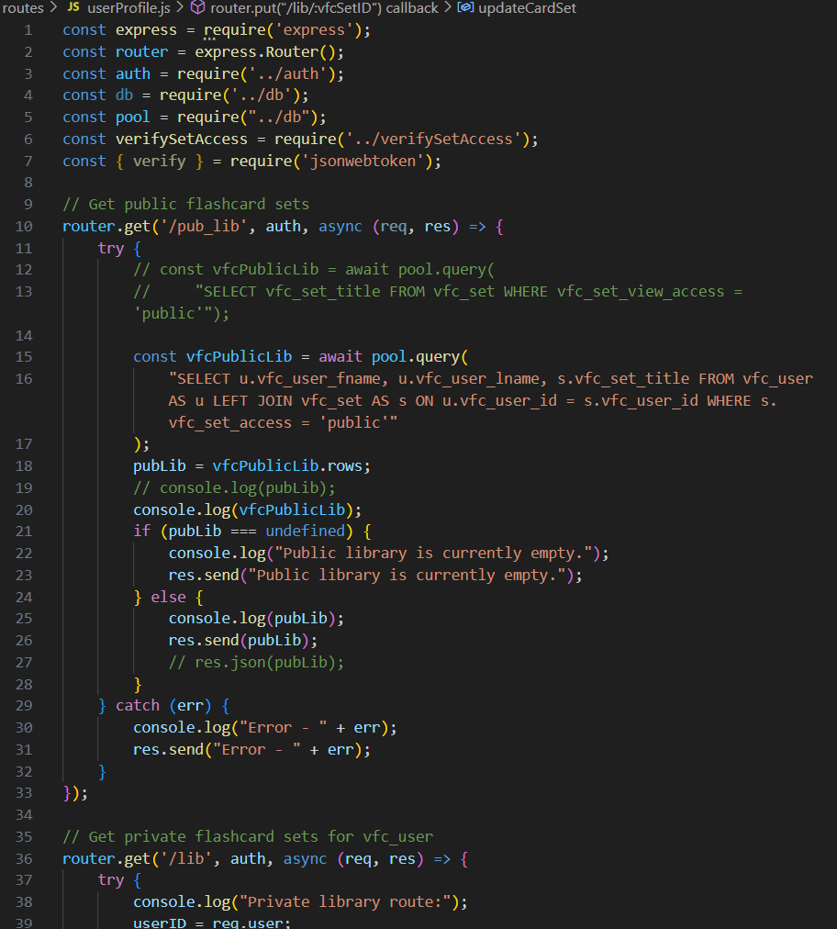
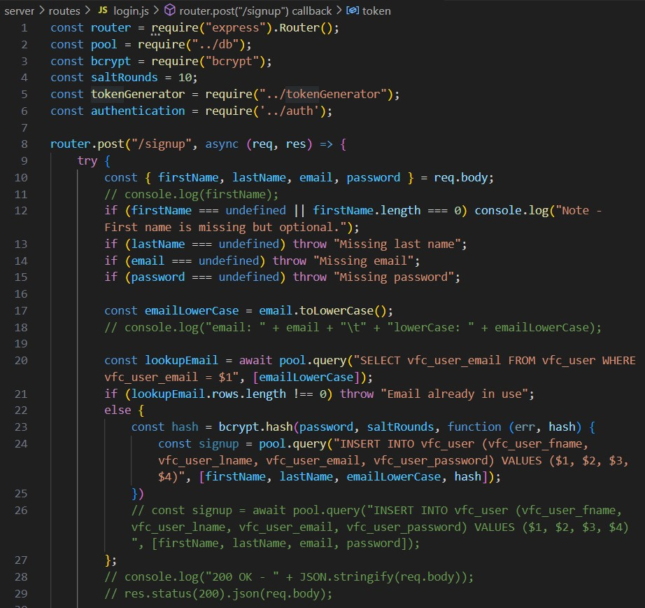
Behind the Scenes Backend
Routes
Login & User Profile
(Using Express & Node.js)
Routes for sign-up and login.
To retrieve sets of flash cards, update/delete cards

Slide 12
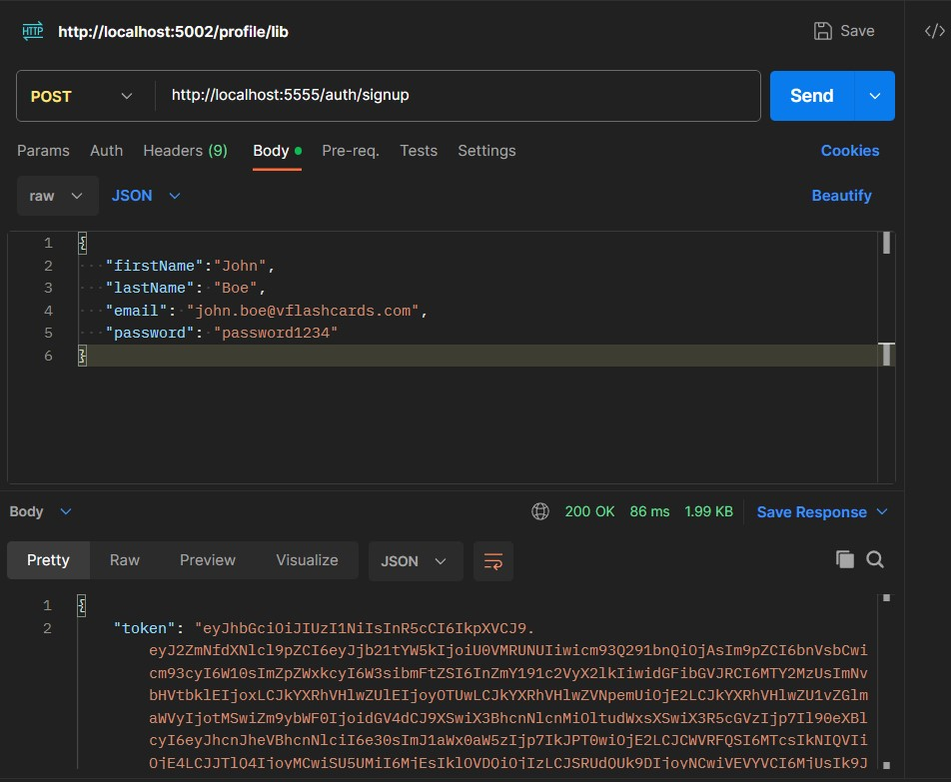
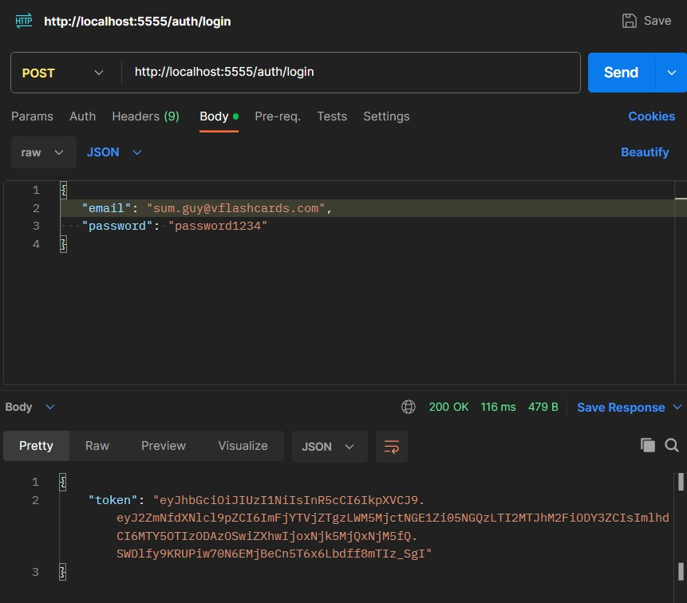
Behind the Scenes Backend
Routes
API Request & Response With Postman
Sign up process for John Boe.
Login authentication for Sum Guy.

Slide 13
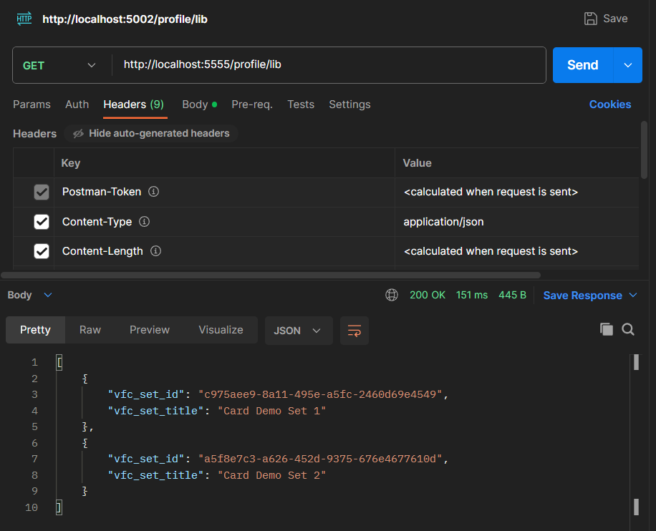
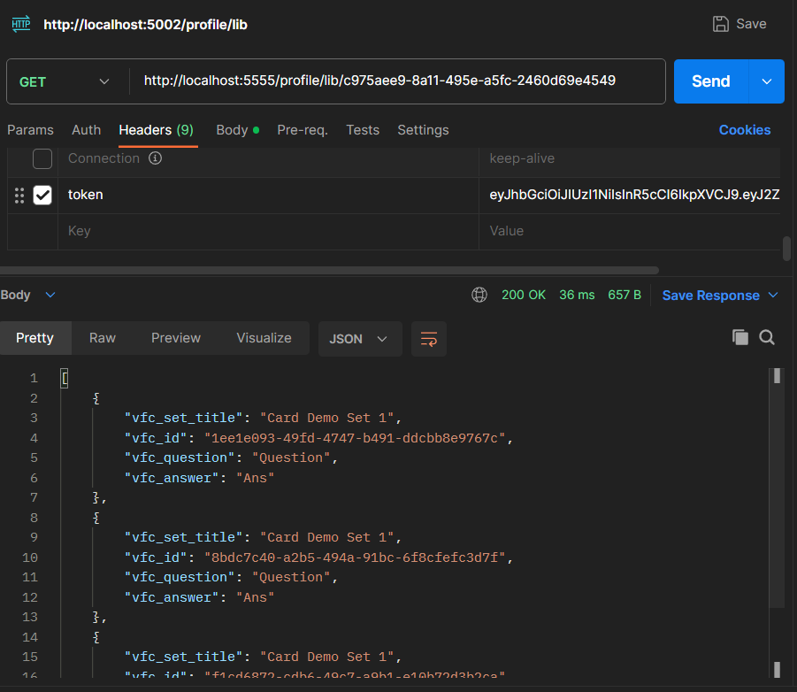
Behind the Scenes Backend
Routes
API Request & Response With Postman
Getting the library set of cards.
Then a list of cards from a set.

Slide 14
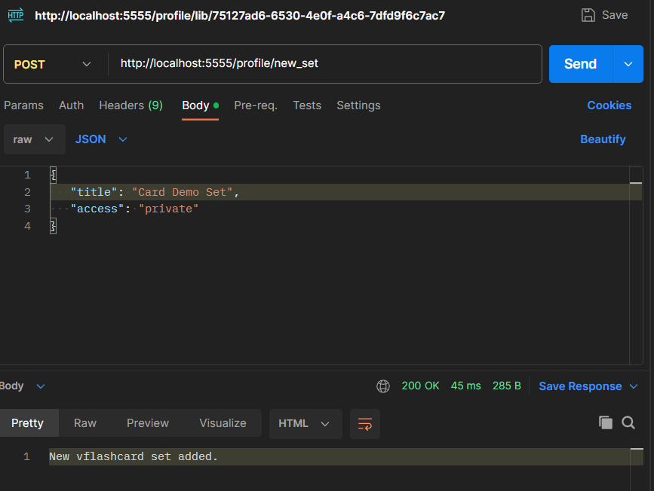
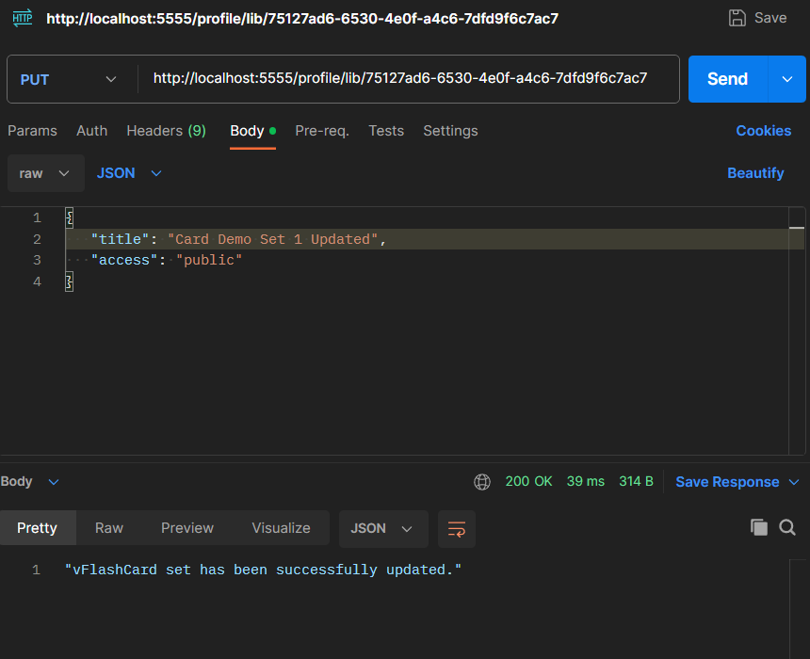
Behind the Scenes Backend
Routes
API Request & Response With Postman
Create a new card set.
Update title and access for a card set.

Slide 15
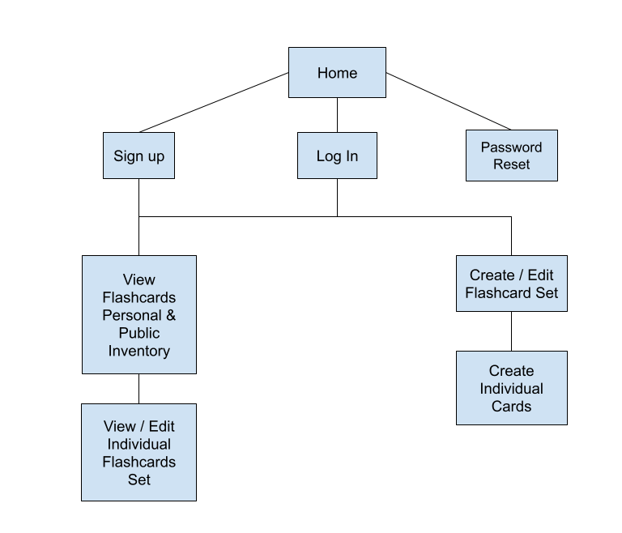
Site Map
Wrap Up
Wrap Up

Slide 16
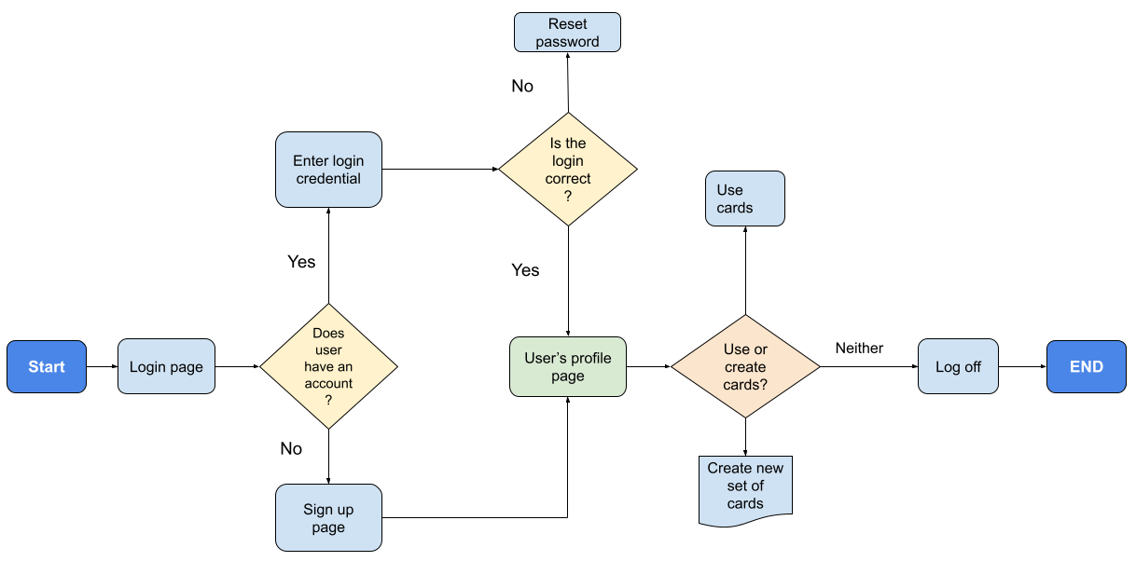
User Flow Chart
Wrap Up
Wrap Up

Slide 17
Challenges
Learning, testing, implementing components such as but not limited to
Bcrypt (for salt & hashing password)
Routes via Express
JSONWebToken
Testing & debugging
JSONWebToken - Took hours to understand the mechanic before implementation and more time to debug.
Database
Had to augment existing knowledge from the college database course. This includes server setup (PostgreSQL), database implementation, running different types of queries on a database, figuring out the appropriate data type, etc.
Working solo
Responsible for all aspects from ideation, planning, designing, coding, debugging, documentation, and understanding all technical concepts.
Lack of sounding board, which can be useful when one wants additional perspective.
Tasks can take significantly more time than expected. One-man team means relying only by oneself.

Slide 18
Project Repository
Wrap Up
Wrap Up
GitHub Repo: https://github.com/not-x/vFlashCards
Time Log: https://github.com/not-x/vFlashCards/blob/main/Time_Log.csv
Project Management Board: https://github.com/users/not-x/projects/1

